Slide 1
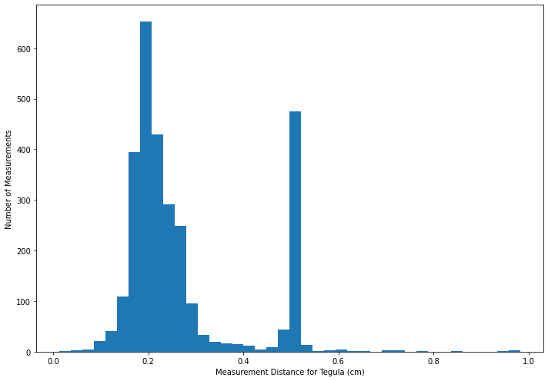
Notes for Nature Data Summary

Slide 2
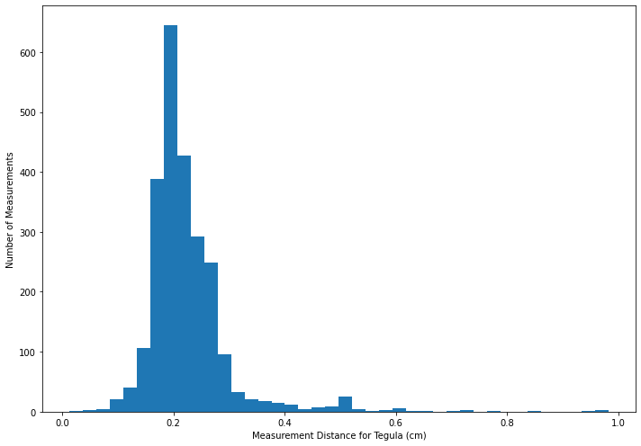
Notes for Nature Data Summary

Slide 3
Notes for Nature Data Summary
It appears there was confusion in selecting the scalebar twice, causing a bimodal distribution
Second histogram excludes one problematic user
All data henceforth excludes this user unless explicitly mentioned otherwise
Over 1 / 6 submissions lost by removing this data (517 / 2954)

Slide 4
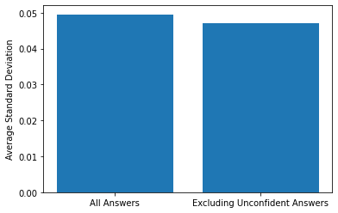
Notes for Nature Data Summary
What happens if we remove answers where users weren’t confident in their ability to measure the bee?
The average standard deviation drops 5.44%.

Slide 5
Notes for Nature Data Summary
How was this calculated?
The standard deviation between measurements for a given bee image was calculated and recorded. These values were averaged and displayed as the first bar. Then, any measurement which had a “No” answer in the "Were you able to measure the bee?“ column was removed, and the same standard deviations and average were calculated with the new dataset.
What does this mean?
Users who weren’t confident in their measurement tended to be off from the other measurements for a given bee image.

Slide 6
Notes for Nature Data Summary
This figure includes all bee images in the standard deviation average.
The standard deviation for images which had all confident answers (all selected “Yes” in the "Were you able to measure the bee?“ column), were included.
This muddles how much the unconfident answers affected standard deviation, since so many unaffected data points were included, which made it harder to shift the average.
Why was this figure included?
It is important to consider how unconfident answers affect the data as a whole, not just the specific images where users lacked confidence.

Slide 7
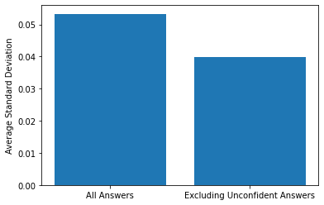
Notes for Nature Data Summary
What happens if we only consider the images that had at least one unconfident answer?
We will compare these images when they have all of their data to when we remove measurements which users lacked confidence on.
The average standard deviation drops 33.60%.

Slide 8
Notes for Nature Data Summary
How was this calculated?
Only bee images with at least one answer response saying “No” in the "Were you able to measure the bee?“ question were included. The standard deviation between measurements for a given bee image was calculated and recorded. These values were averaged and displayed as the first bar. Then, any measurement which had a “No” answer in the "Were you able to measure the bee?“ column was removed, and the same standard deviations and average were calculated with the new dataset.
What does this mean?
Users who weren’t confident in their measurement tended to be far off from the other measurements for a given bee image. Their measurement was significant in its effect on the standard deviation for that bee image (33% change when excluded), but not so for the data as a whole (5% change when excluded) since only 2.6% of measurements (78 / 2954) lacked confidence.

Slide 9
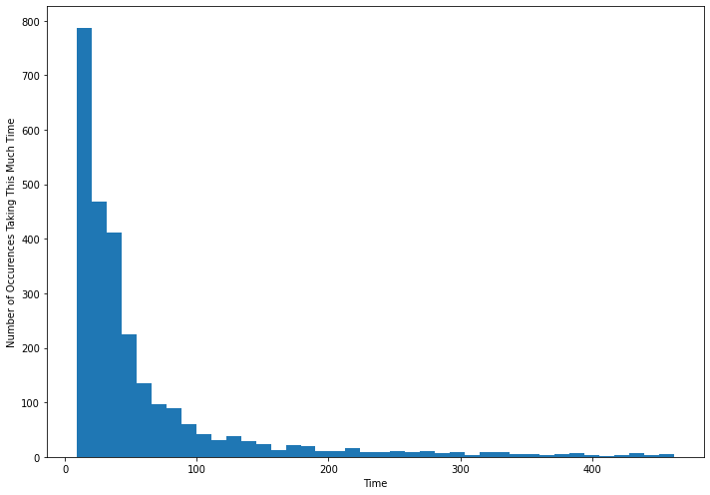
Notes for Nature Data Summary
Distribution of time taken and how many occurrences there were of this time.
Excludes quickest 5% and slowest 5% of data, starting at 9 seconds and ending at 467 seconds.
Average time to complete was 58 seconds.
Median time to complete was 33 seconds.

Slide 10
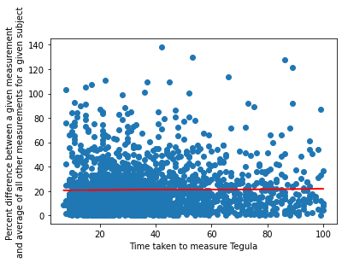
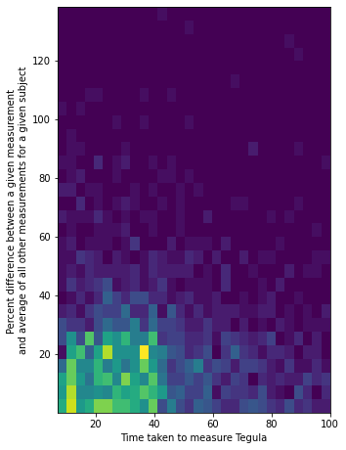
Notes for Nature Data Summary
All results taking more than 100 seconds to measure excluded.
Shows relationship between time taken to measure tegula and precision.
NOTE: Highest Precision has a y-value of ZERO.
Slope of the best fit line is 0.011.

Slide 11
Notes for Nature Data Summary
How was this calculated?
Data was grouped by which bee image it belonged to. Every tegula measurement was compared to the average of the other tegula measurements for that image, and the percent difference between these two values recorded. This percent was plotted against how much time it took to obtain this measurement.
What does this mean?
Most people took less than 40 seconds and obtained results within 20% of the average.
There is no correlation between time taken and precision (slope of best fit line is almost exactly 0).

Slide 12
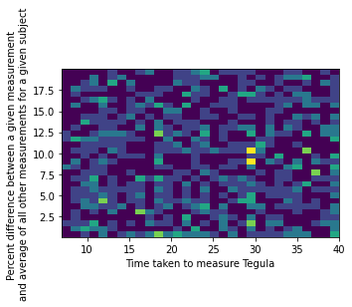
Notes for Nature Data Summary
What if we focus on the region of dissimilarity < 20% and time < 40s (the bright spot on the heat map)?
Still no correlation between time taken and precision.

Slide 13
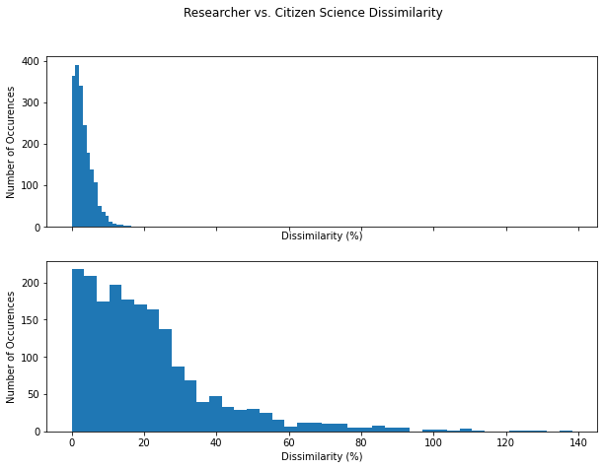
Notes for Nature Data Summary
Compare dissimilarity percent between tegula measurements for researchers and citizen scientists.
Maximum difference for researchers was 20.6%.
Maximum difference for citizen scientists was 138.3%.
Average difference for researchers was 3.3%.
Average difference for citizen scientists was 21.1%.

Slide 14
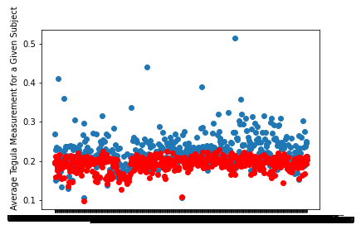
Notes for Nature Data Summary
Despite large discrepancies between citizen scientists’ measurements, their averages tended to be close to researchers’.
Averaged 13.7% difference between researchers’ average tegula measurement and citizens scientists average tegula measurement.
Red = researchers
Blue = citizen scientists

Slide 15
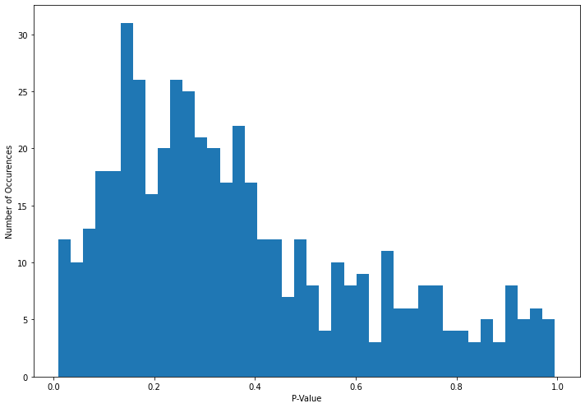
Notes for Nature Data Summary
Please note this data was obtained from using an inappropriate T-Test, a later revision is included on Slide 21.
P-Value distribution from unpaired T-Test measuring the difference between tegula measurements of researchers and citizen scientists for each image.
Only 21 / 479 (4.3%) results statistically significant (p < 0.05).
We expect 5% of results to be statistically significant by chance.
Therefore, there is no meaningful difference between researchers’ measured tegula average and citizen scientists’.
Average P-Value is 0.37.

Slide 16
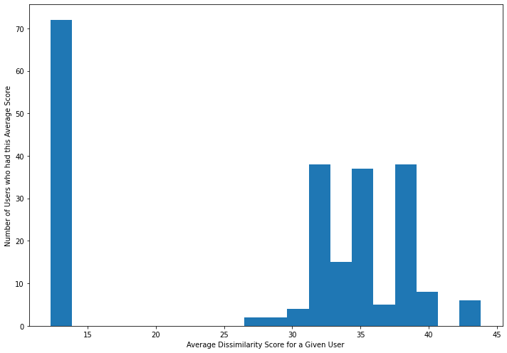
Notes for Nature Data Summary
Distribution of average dissimilarity for all measurements for every user.
Can we filter problematic users to obtain better results?
No obvious outliers.
This data includes the problematic user from the very beginning (Average Dissimilarity = 26.58%).

Slide 17
Notes for Nature Data Summary
Why is their dissimilarity score so low?
Notes for Nature allowed them to submit measurements for the same image more than once!
This shifted the average in their favor.
Why did Notes for Nature allow this?
There were only 490 images and this user had 517 submissions.
They had to redo images at some point.
Yet, their 517 submissions only covered 202 of the images.
All 490 images had at least one submission by the time this user started submitting.
This means it was not an issue where Notes for Nature rolls out new images only once old ones have been completed.
Most images already had their 5 measurements when this user started.

Slide 18
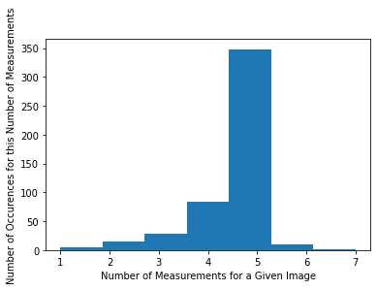
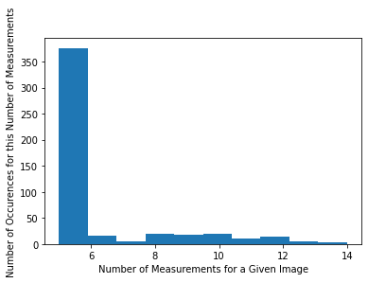
Notes for Nature Data Summary
Distribution of how many measurements each image had before and after the problematic user began submissions.
Why did Notes for Nature stack so many submissions on certain images, rather than evenly distributing them?
It is worth noting 75% of the measurements (517 / 696) submitted after the first histogram were from the problematic user.
This does not appear to be a glitch where images which had less than 5 measurements were continually cycled and gained more submissions, nor does it appear to be a glitch where images with exactly 5 measurements had this issue.

Slide 19
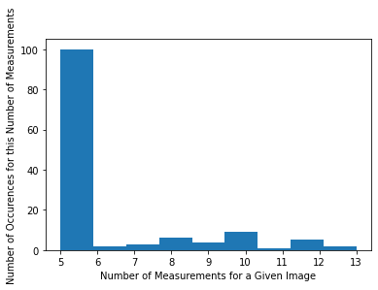
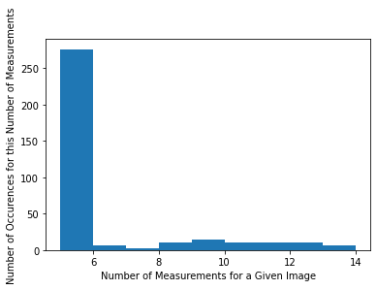
Notes for Nature Data Summary
Distribution of how many measurements each image had after the problematic user began submissions.
First graph includes only images which had less than 5 submissions before problematic user began.
Second graph includes only images which had exactly 5 submissions before problematic user began.
Images with too many measurements (> 5) equally present regardless of how many measurements they had before.
This indicates that images with too few measurements did not get stuck in a cycle where the problematic user was able to continuously submit additional measurements for them.
This also indicates that the images with enough submissions did not get stuck in this cycle either.

Slide 20
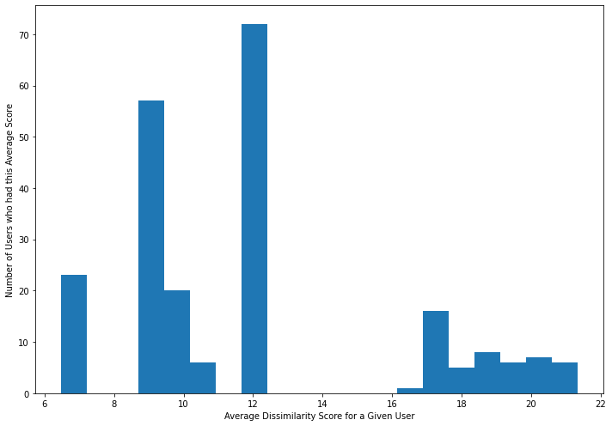
Notes for Nature Data Summary
Distribution of average dissimilarity for all measurements for every user.
Excludes problematic user.
Average dissimilarity by user down to 12.1% from 27.84% previously.
From slide 16
Problematic user greatly increased dissimilarity scores by skewing measurements on 202 images they had submissions for.

Slide 21
Notes for Nature Data Summary
Averaged 13.7% difference between researchers’ average tegula measurement and citizen scientists average tegula measurement.
Statistically significant difference when comparing citizen scientists’ measurements as a whole to researchers’ measurements with an independent samples T-test (P-Value = 6.0 x 10^-46).
Red = researchers
Blue = citizen scientists
Given Subject (Image)

Slide 22
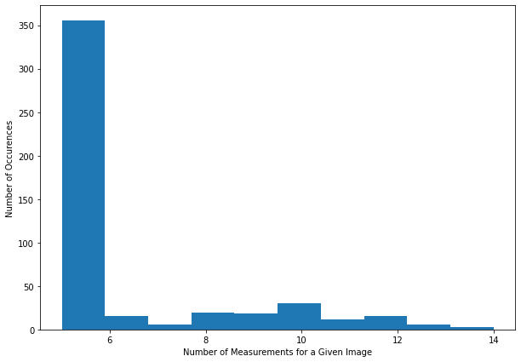
Notes for Nature Data Summary
Distribution of how many measurements each image has.
Most images (355 / 479) have 5 measurements.
25.89% (124 / 479) of images have more than 5 measurements.

Slide 23
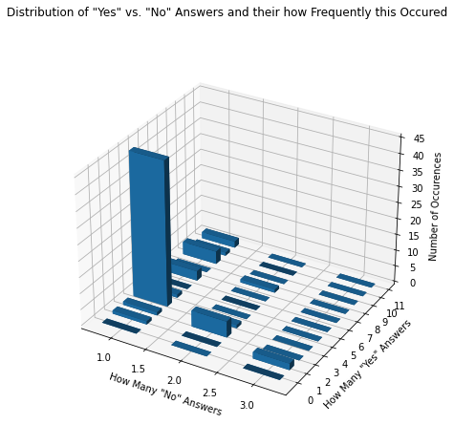
Notes for Nature Data Summary
Distribution of how many measurements lacked confidence vs. how many had confidence for a given image and how frequently this occurred.
Peaks at (1,4), (2,3) and (3,2) indicate 5 total measurements to be the norm despite unconfident answers.

Slide 24
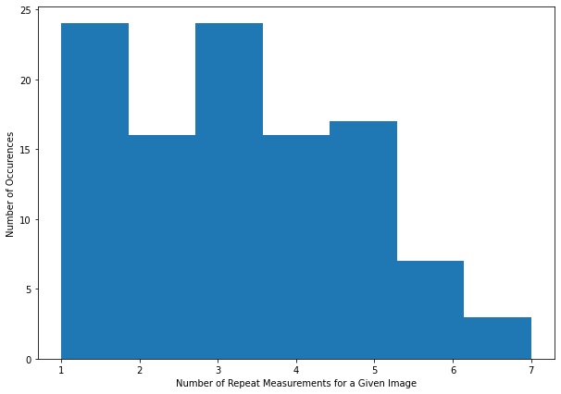
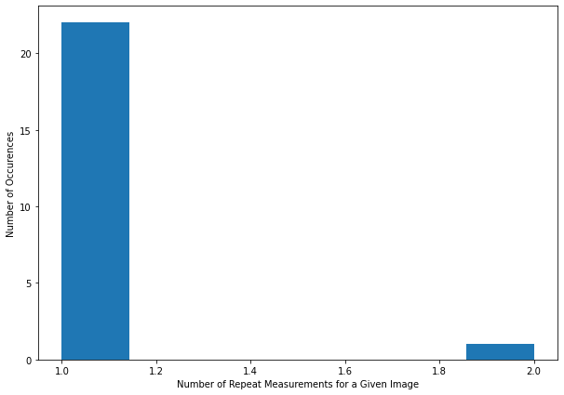
Notes for Nature Data Summary
Distribution of how many repeat measurements each image had.
Repeat measurement = Measurement from a user who already measured this image once
Graph excludes all images with zero repeats.
Top graph = Includes the problematic user.
Total of 107 images with repeat measurements.
Average of 3.17 repeats per image.
Bottom Graph = Excludes the problematic user.
Total of 23 images with repeat measurements.
Average of 1.04 repeats.

Slide 25
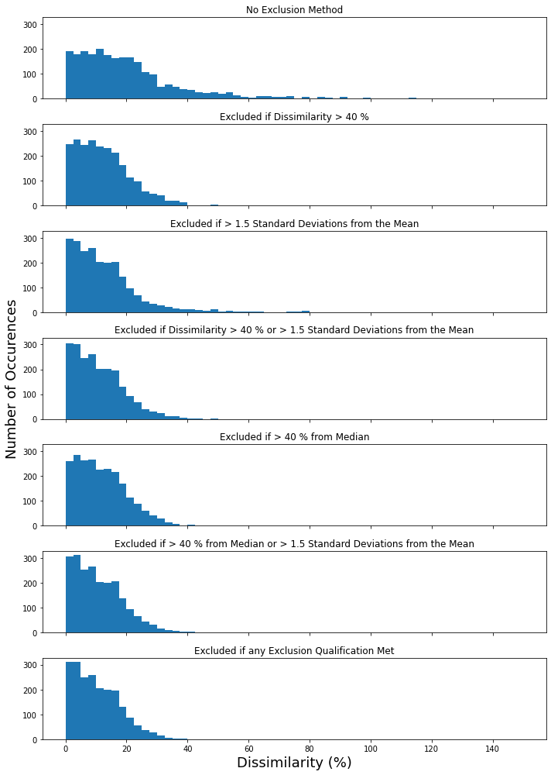
Notes for Nature Data Summary
Distribution of dissimilarity between one measurement and the average of the other measurements for a given image.
All data excludes problematic user by default.
First graph is for all data (no exclusionary method).
Second graph excludes data with dissimilarity > 40%.
Third graph excludes data > 1.5 standard deviations from the mean.
Fourth graph excludes data with dissimilarity > 40% and data > 1.5 standard deviations from the mean.
Fifth graph excludes data > 40% from the Median.
Sixth graph excludes data > 40% from the Median or > 1.5 Standard Deviations from the Mean.
Seventh Graph Excludes data with > 40 % dissimilarity or > 40% from the Median or > 1.5 Standard Deviations from the Mean.

Slide 26
Notes for Nature Data Summary
How was this calculated?
New dissimilarity distributions obtained by looking at all data, removing certain points based on the exclusionary method specified, then determining dissimilarity among the new data.
This creates data that may look like it should have been excluded (i.e., points above 40% dissimilarity when anything > 40% dissimilarity was removed) but exists because there is a new benchmark with the previous data removed.
What does this mean?
All methods bring almost all data below 40% dissimilarity, except for excluding data > 1.5 standard deviations from the mean.
All methods skew data further left (tightens data to lower dissimilarity). However, excluding data > 40% dissimilarity and excluding data > 40% from the median both retain their shape more than other methods.

Slide 27
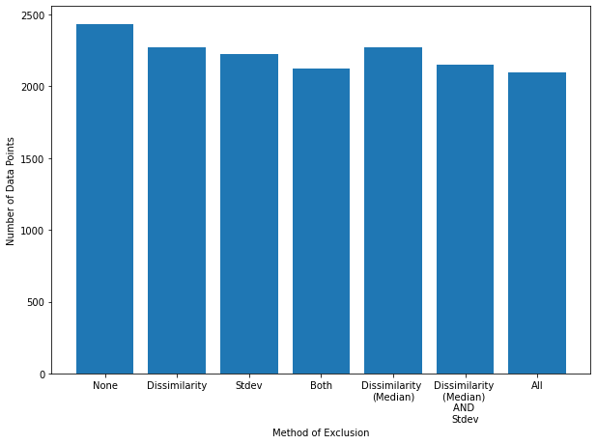
Notes for Nature Data Summary
Data with no exclusion method retains 2436 measurements.
Excluding data with dissimilarity > 40% retains 2270 measurements.
This is 93.2% of data.
This is a loss of 6.8% (166 measurements) of data.
Excluding data greater than 1.5 standard deviations from the mean retains 2228 measurements.
This is 91.5% of data.
This is a loss of 8.5% (208 measurements) of data.
Excluding data with dissimilarity > 40% and greater than 1.5 standard deviations from the mean retains 2125 measurements.
This is 87.2% of data.
This is a loss of 12.8% (311 measurements) of data.
Excluding data > 40% from the Median retains 2274 measurements.
This is 93.4% of data.
This is a loss of 6.7% (162 measurements) of data.
Excluding data with dissimilarity > 40% or > 1.5 standard deviations from the mean retains 2148 measurements.
This is 88.2% of data.
This is a loss of 11.8% (288 measurements) of data.
Excluding data with > 40 % dissimilarity or > 40% from the Median or > 1.5 Standard Deviations from the Mean retains 2096 measurements.
This is 86.0% of data.
This is a loss of 14.0% (340 measurements) of data.

Slide 28
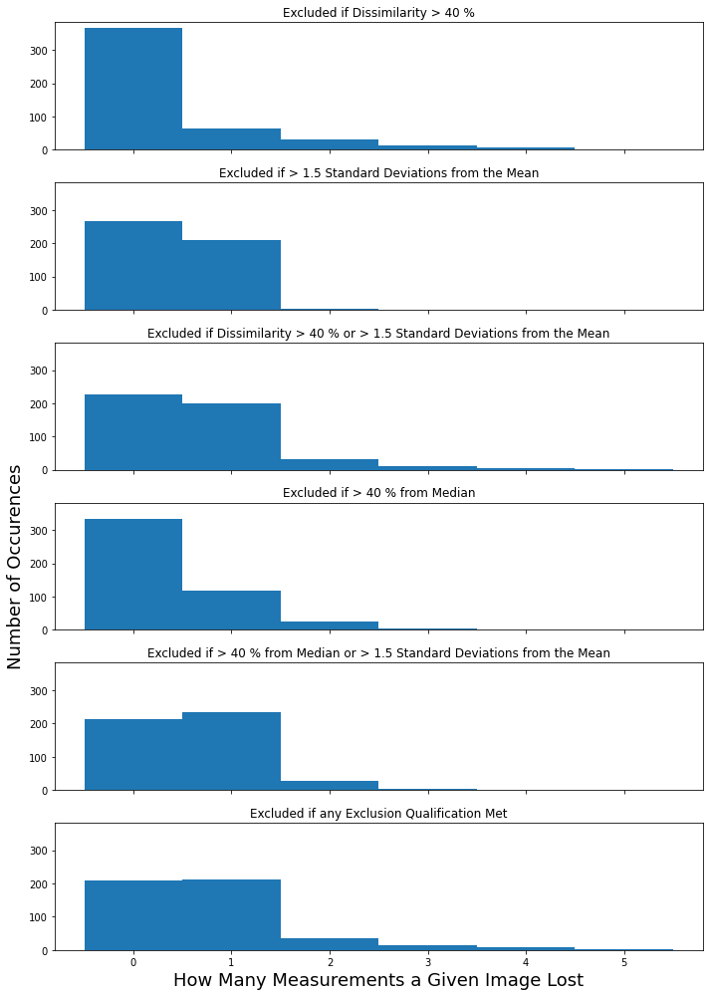
Notes for Nature Data Summary
Distribution of how many measurements a given image lost, separated by exclusionary method.
Excluding data if it is > 1.5 standard deviations from the mean removes 1 measurement from ~ 40% of images.
Excluding data with > 40% dissimilarity or if it is > 40% from the median removes more than one measurement from 50 and 28 images, respectively.
Comparatively, excluding data if it is > 1.5 standard deviations from the mean removes more than one measurement from only 2 images.

Slide 29
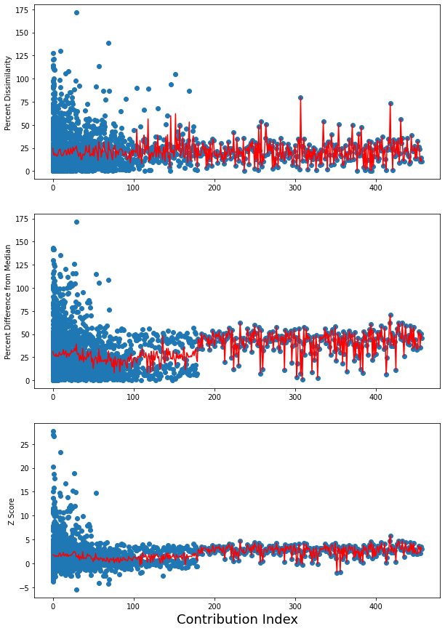
Notes for Nature Data Summary
What index a given measurement is compared to its precision.
Index = how many measurements has this user done before.
I.e., if a user is on their third image, they have submitted two before (Index = 2).
Graphs separated by precision measuring technique.
Red line = average of all precision measurements at a given index.
Anything past index 180 is one user.
Gives insight into how much an experienced user’s measurements vary.

Slide 30
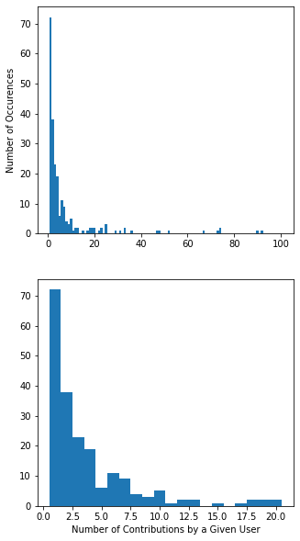
Notes for Nature Data Summary
Distribution of how many measurements each user contributed in total.
Only 3 users contributed more than 100 measurements.
89.8% (203 / 226) users contributed 20 or fewer measurements.
Average number of contributions was 10.78 measurements.
Median number of contributions was 3 measurements.
31.9 % (72 / 226) of users only contributed one measurement.

Slide 31
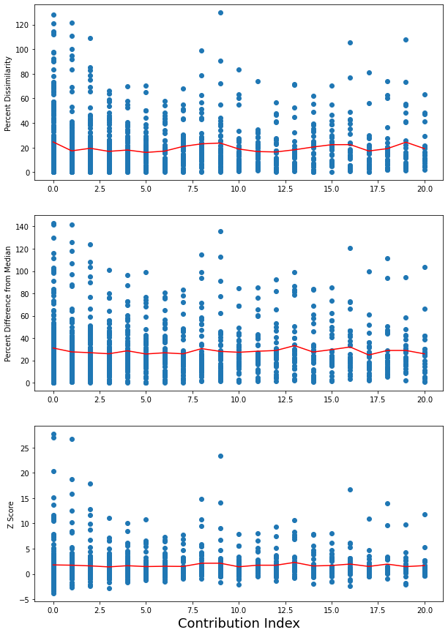
Notes for Nature Data Summary
Only considers contribution index < 21 of graph from slide 29.
Still no correlation between experience and precision.
Considers all three forms of precision discussed.
Percent dissimilarity of data from average of other measurements.
Percent difference of data from median.
Z-Score of data.
Similar distribution regardless of precision measuring method.

Slide 32
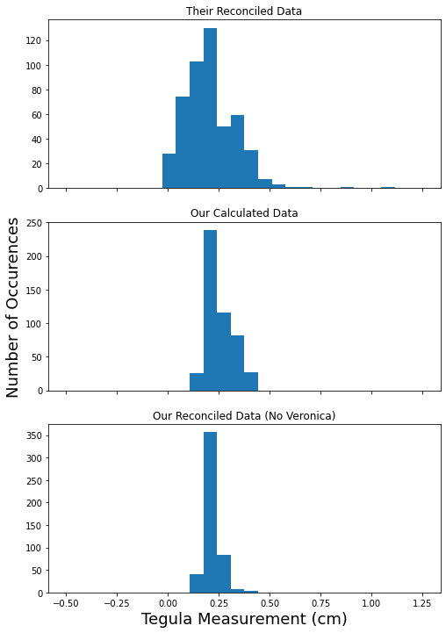
Notes for Nature Data Summary
Distribution of tegula measurements based on what data is used.
Their reconciled data has values as low as 0 cm (row 299) and as high as 1.32 cm (row 18).
None of the data comes close to this based on our calculations (with Veronica).
min = 0.13 cm
max = 0.44 cm
Their data is far more spread out.
If their values are different because of excluded data, it appears excluding this data increased the variation.
11 images appear twice in reconciled data.
Each has different values when it reappears.

Slide 33
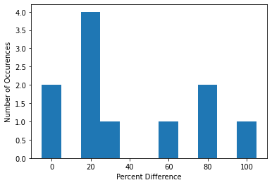
Notes for Nature Data Summary
Distribution of percent difference between first and second average measurement for repeated images in Reconciled Data.

Slide 34
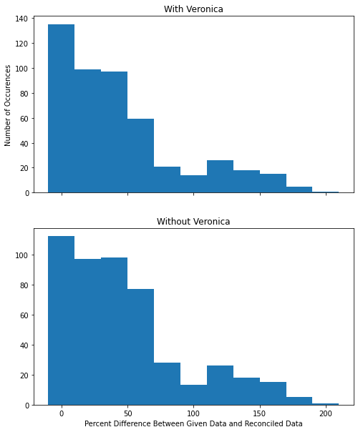
Notes for Nature Data Summary
Distribution of percent difference between our measured data and their reconciled data.
Separated by which dataset we are using.
Extremely different average Tegula Measurement despite using the same unreconciled data.
Why is this happening?

Slide 35
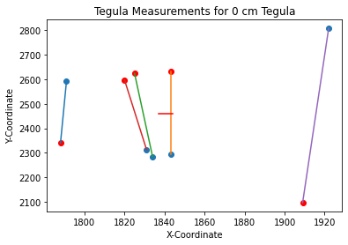
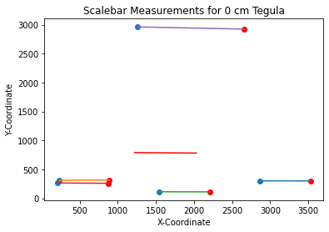
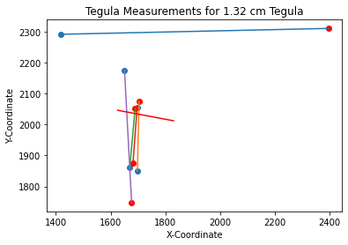
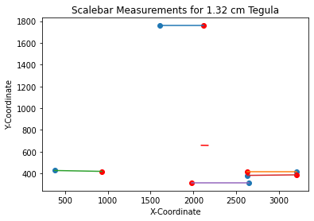
Notes for Nature Data Summary
Notes for nature averages X-coordinates and Y-coordinates for a given image, NOT individual measurements (as we do)!
This means if some users select the top of the tegula first and some select the bottom first, the reconciled coordinate average will be in the middle
Similarly, users not selecting the exact same block on the scalebar will greatly skew measurements when coordinates are averaged.
Blue point = first coordinate.
Red point = second coordinate.
Red line = line between average of first coordinates and average of second coordinates (reconciled data).

Slide 36
Notes for Nature Data Summary
In how many instances was the Tegula measured and then the scalebar?
Only 20 / 2437 measurements.
How was this determined?
Looked at measurements grouped by which subject they belonged to. Calculated the theoretical tegula length if the tegula and scalebar measurements had been switched, and did so for each of the measurements in this group. See if any measurements in this group were within 10% of any of these calculated values. If any measurements are in this range AND far from the average tegula measurement (> 50%), the measurements occurred in the wrong order.
The measurement must be far from the average tegula measurement because calculating the theoretical tegula length if the tegula and scalebar measurements had been switched for a tegula length where they were actually switched would give a value close to the mean, and data would likely be within 10% of this.
How was the aforementioned tegula length (if the tegula and scalebar measurements had been switched) calculated?
(0.25cm^2 / tegula length) for each tegula length a subject had.

Slide 37
Notes for Nature Data Summary
Proof:
If scalebar measured first, pixel distance of tegula length converted to cm via:
correct tegula length (cm) = tegula length (pixels) * [ 0.5 cm / scalebar (pixels) ]
If scalebar and tegula length switched this figure would be:
mistaken tegula length (cm) = scalebar (pixels) * [ 0.5 cm / tegula length (pixels) ]
The conversion between these equations is:
mistaken tegula length (cm) = 0.25cm^2 / correct tegula length (cm)
scalebar (pixels) * [ 0.5 cm / tegula length (pixels) ] = 0.25cm^2 / { tegula length (pixels) * [ 0.5 cm / scalebar (pixels) ] }
scalebar (pixels) * [ 0.5 cm / tegula length (pixels) ] = 0.25cm^2 * { scalebar (pixels) / [ 0.5 cm * tegula length (pixels) ] }
scalebar (pixels) * [ 0.5 cm / tegula length (pixels) ] = 0.5cm^2 * { scalebar (pixels) / [ 1 cm * tegula length (pixels) ] }
scalebar (pixels) * [ 0.5 cm / tegula length (pixels) ] = 0.5cm * scalebar (pixels) / [ 1* tegula length (pixels) ]
scalebar (pixels) * [ 0.5 cm / tegula length (pixels) ] = scalebar (pixels) * 0.5cm / [ tegula length (pixels) ]
scalebar (pixels) * [ 0.5 cm / tegula length (pixels) ] = scalebar (pixels) * [ 0.5cm / tegula length (pixels) ]

Slide 38
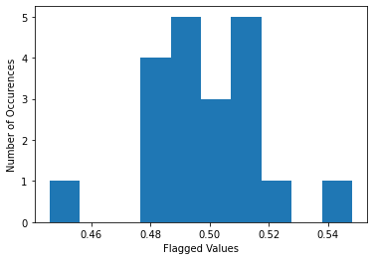
Notes for Nature Data Summary
Values close to 0.5 flag themselves.
Formula to flag:
Within 10% of 0.25cm^2 / tegula length (cm).
Done for all values of tegula length for a given subject.
Intended to flag different tegula length, far off from normal values.
Since 0.25 / 0.5 = 0.5, 0.5 values are always within 10% of 0.25cm^2 / tegula length (cm)
Also identifies mistakes where tegula was measured twice.
No values measured tegula first then scalebar.
No values flagged that were not close to 0.5, where they would flag themselves.
Indicates directions were clear in which order you should measure.

Slide 39
Notes for Nature Data Summary
In how many instances was the 1 cm block on the scalebar measured instead of the 0.5 cm block?
Only 2.7% (67 / 2437) measurements.
Not a significant issue.
Directions were fairly clear on this matter.
How was this determined?
Listed the pixel distance for every single scalebar measurement for a given image. Doubled each distance and checked to see if any scalebar measurements were within 10% of this value.
Excluded one case where 4 measurements were the double of one value (More likely one user measured half the distance once than four users measured twice the distance each time).
Most images with the 1 cm block measured had this occur only once.
3 images had the 1 cm block measured twice

Slide 40
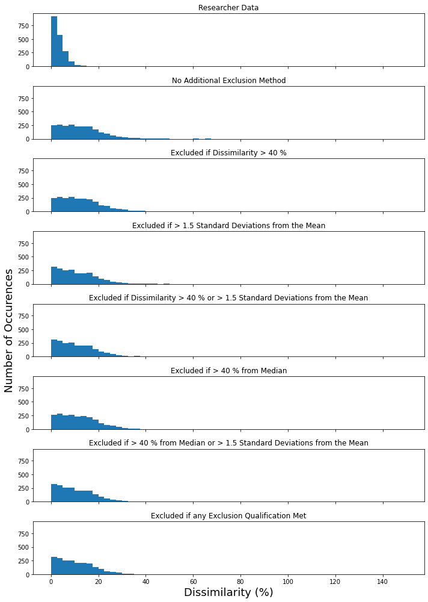
Notes for Nature Data Summary
Remove data where 1 cm scalebar measured or Tegula Distance > 0.4 cm (Outliers).
Distribution of dissimilarity between data after using methods previously mentioned to remove additional data.

Slide 41
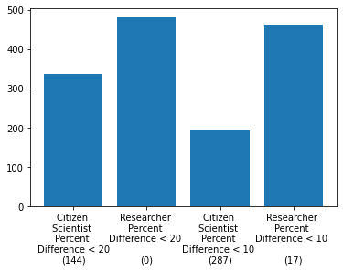
Notes for Nature Data Summary
Look at all measurements for a given image (after removing aforementioned outliers).
See if there are at least 3 measurements within 20% of each other for each image.
Count how many images have these 3+ measurements.
Repeat this process for researcher measurements AND see how many images also have 3 measurements within 10% of each other for both groups.
Number in parentheses = how many images did NOT have at least 3 measurements.

Slide 42
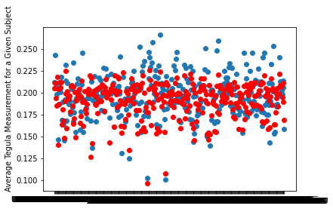
Notes for Nature Data Summary
Only analyze the 336 images with 3+ measurements within 20% of each other and only consider these measurements.
Compare Researchers’ average measured Tegula to Citizen Scientists’ average measurement for each image.
Average percent difference = 5.8%.
Average percent difference previously = 13.7%.
Citizen Scientists measure 2.5% higher than researchers on average.
Statistical significance from independent samples T-test comparing Researchers’ average measurements to Citizen Scientists’ (P-Value = 0.0023).
Previous P-Value = 6.0 x 10^-46.
Given Subject (Image)

Slide 43
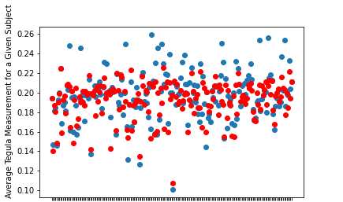
Notes for Nature Data Summary
Only analyze the 193 images with 3+ measurements within 10% of each other and only consider these measurements.
Compare Researchers’ average measured Tegula to Citizen Scientists’ average measurement for each image.
Average percent difference = 5.24%.
Citizen Scientists measure 2.2%. higher than researchers on average.
Statistical significance from independent samples T-test comparing Researchers’ measurements to Citizen Scientists’ (P-Value = 0.033).
Given Subject (Image)

Slide 44
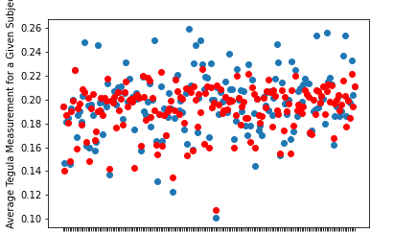
Notes for Nature Data Summary
Reduce accepted percent difference between 3+ measurements until the difference between Citizen Scientists’ and Researchers’ measurements is statistically insignificant.
Only accepting measurements within 9.47% of each other and analyzing images with 3 or more of these measurements yields a P-Value of 0.052 in an independent samples T-test comparing Researchers’ average Tegula measurements to Citizen Scientists’.
177 / 480 Images left with 3+ measurements.
Average percent difference = 5.3%
Citizen Scientists measure 2.1% higher than Researchers on average.
Given Subject (Image)

Slide 45
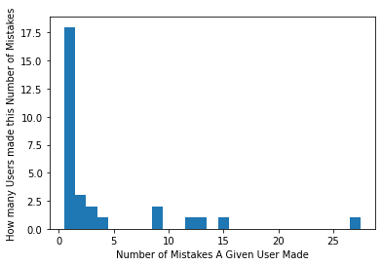
Notes for Nature Data Summary
Distribution of how many times a user measured a Tegula Distance > 0.4 cm or measured the 1 cm scalebar.
14 / 30 of these users not logged in.
27 / 119 of these mistakes by users not logged in.
62 / 119 mistakes had the Tegula Distance > 0.4 cm.
67 / 119 mistakes measured the 1 cm scalebar.

Slide 46
What we did
Their averages didn’t make sense
Increased confidence in comparing users’ data to one another
We want to keep 5 measurements (no less)
Improve instructions and relaunch
Reach out to advisor about research credits in fall

